Slide 1
Ethereum price prediction
Wafi Almustahi

Slide 2

Blockchain technology
Blockchain technology is most simply defined as a decentralized, distributed ledger that records the provenance of a digital asset.
Digital assets are distributed instead of copied or transferred.
The asset is decentralized,
allowing full real-time access.
A transparent ledger of changes preserves
integrity of the document,
which creates trust in the asset.
https://builtin.com/blockchain

Slide 3

Crypto currencies
A cryptocurrency (or crypto currency) is a digital asset designed to work as a medium of exchange that uses strong cryptography to secure financial transactions, control the creation of additional units, and verify the transfer of assets.

Slide 4

Defi and ethereum
DeFi is the movement that leverages decentralized networks to transform old financial products into trustless and transparent protocols that run without intermediaries. We have 218 DeFi projects listed and 200 of them built on Ethereum.
https://defiprime.com/ethereum

Slide 5
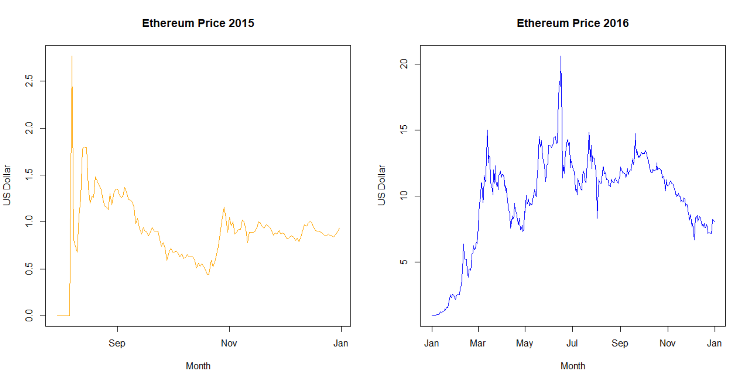
Ethereum Price

Slide 6
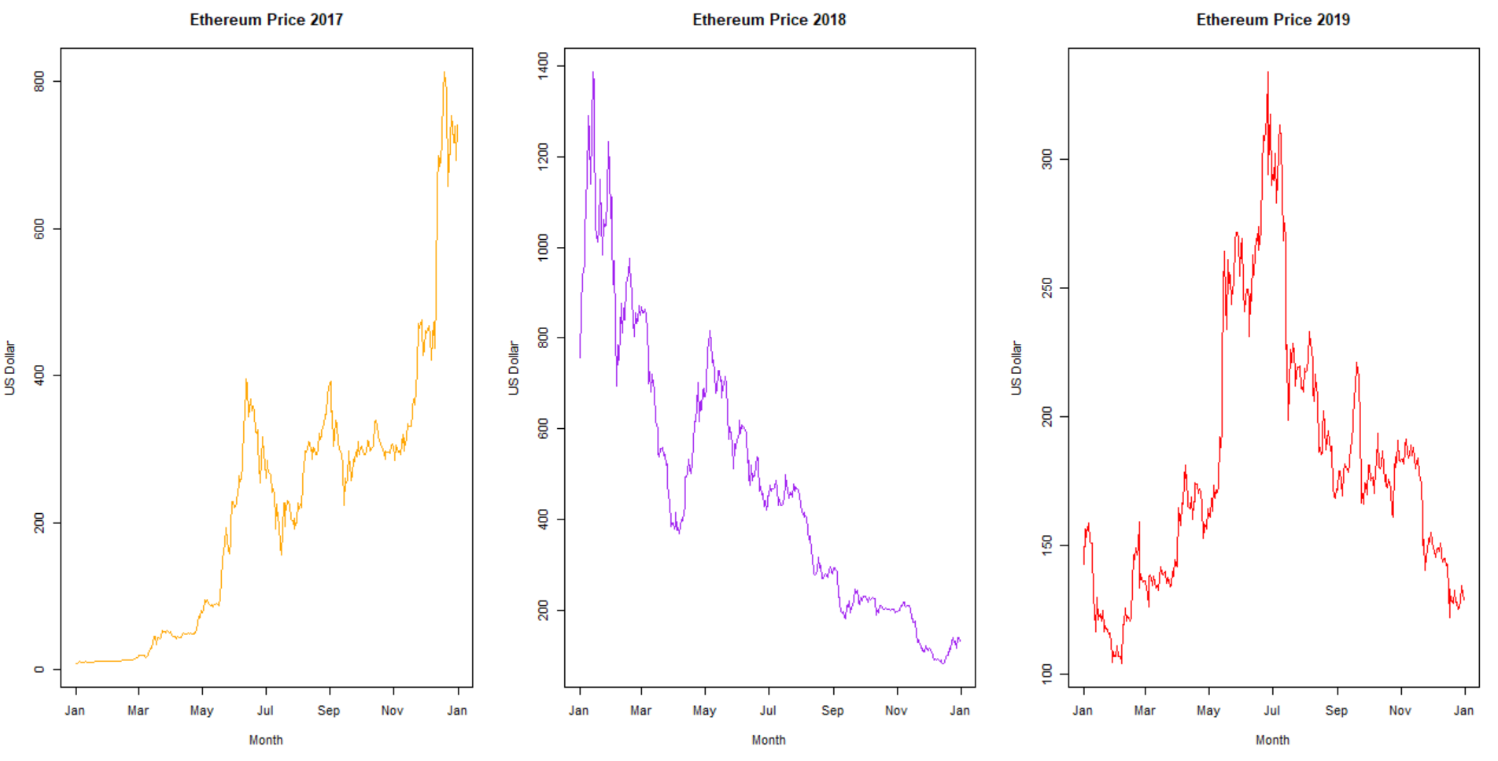
Ethereum Price

Slide 7
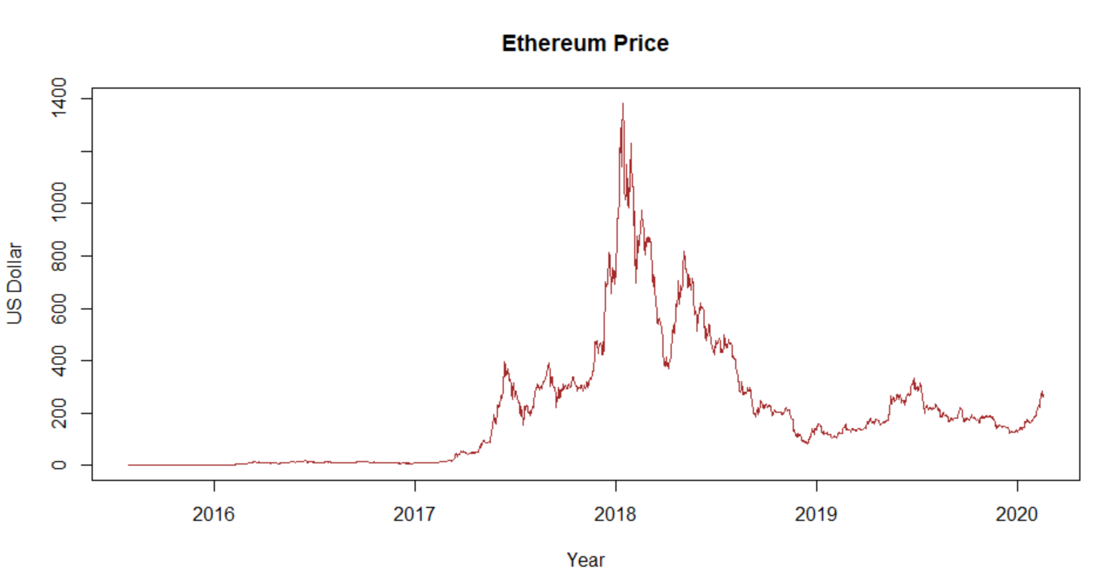
Ethereum Price

Slide 8
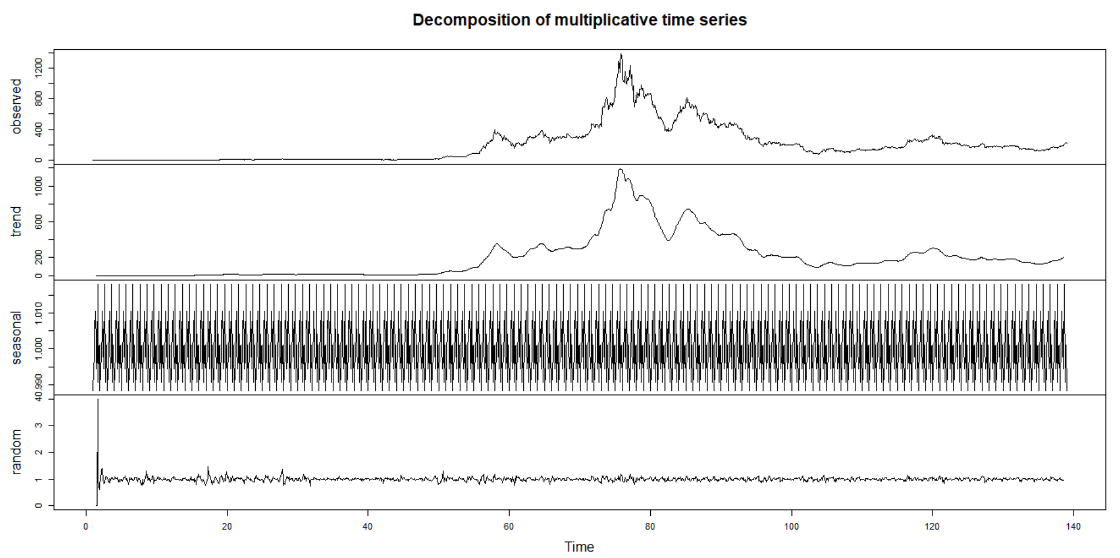
Decomposition ts

Slide 9
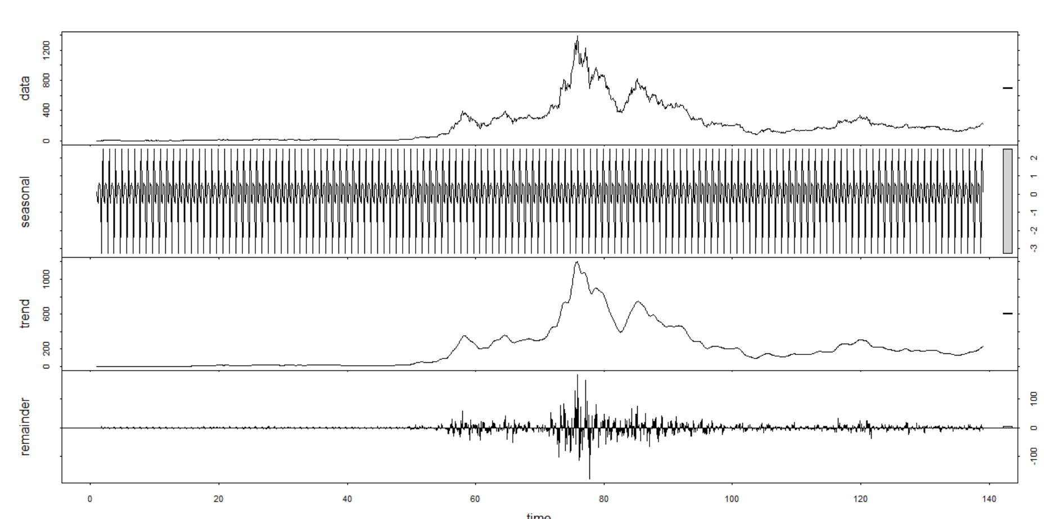
Decomposition ts

Slide 10
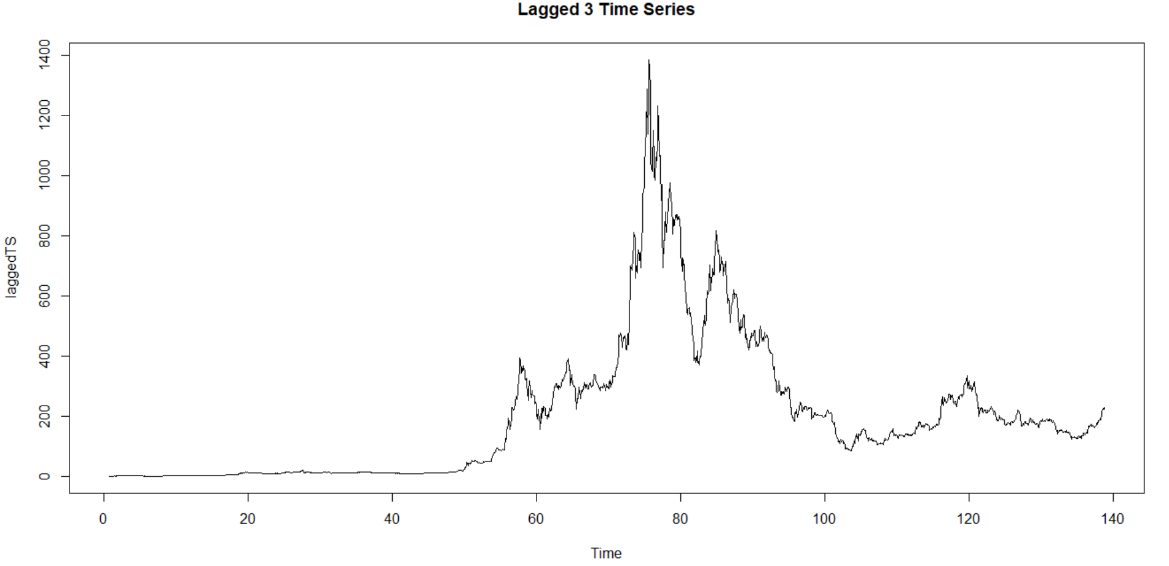
Ethereum Price

Slide 11
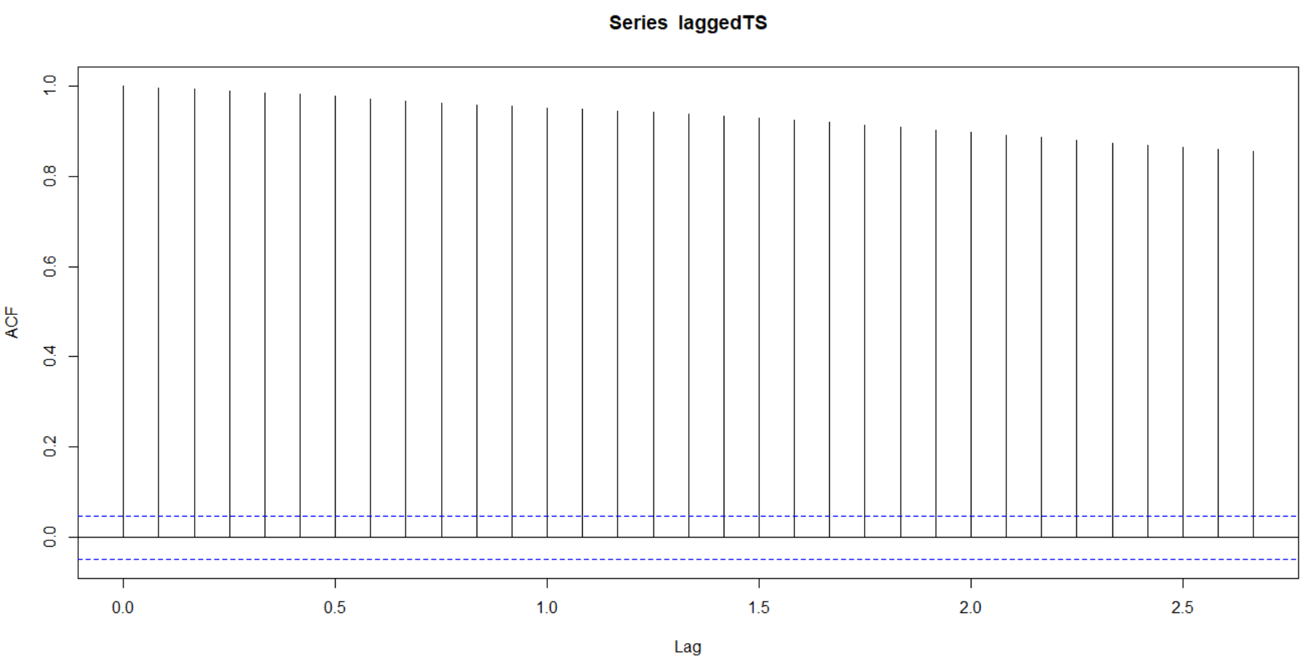
ACF

Slide 12
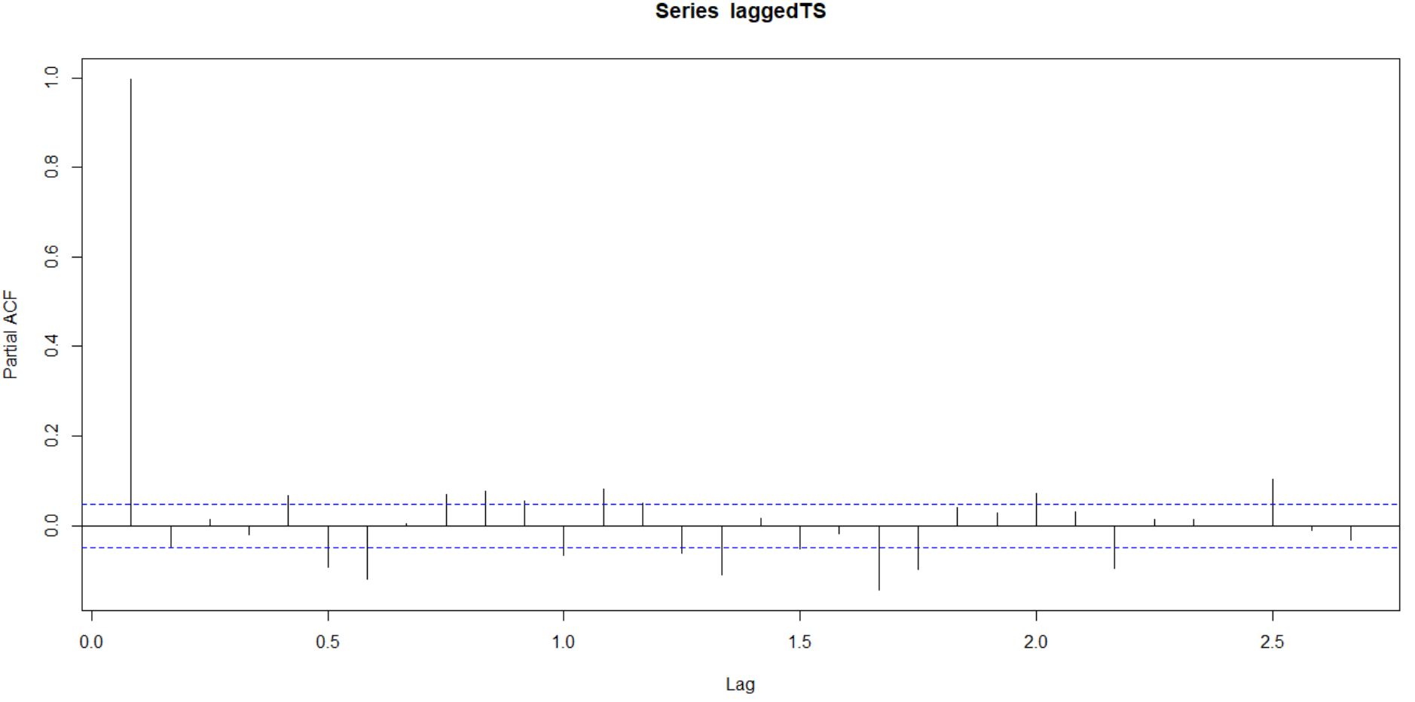
Partial autocorrelation function

